Slide 1
Welcome to Narcoossee Middle School
Incoming Sixth Grade Student Orientation
Translation Services are available
Servicios de traduccion disponibles

Slide 2
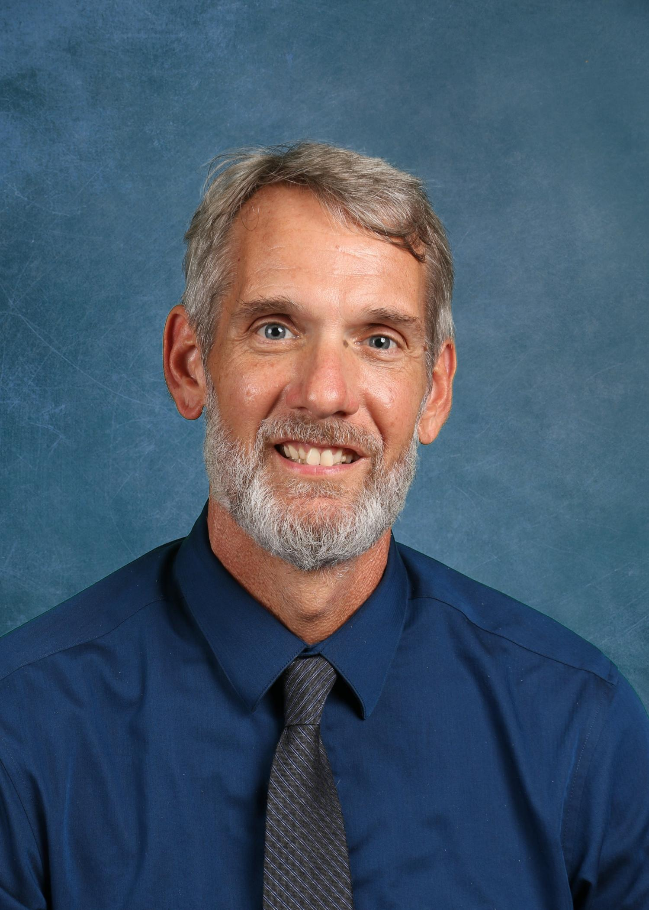
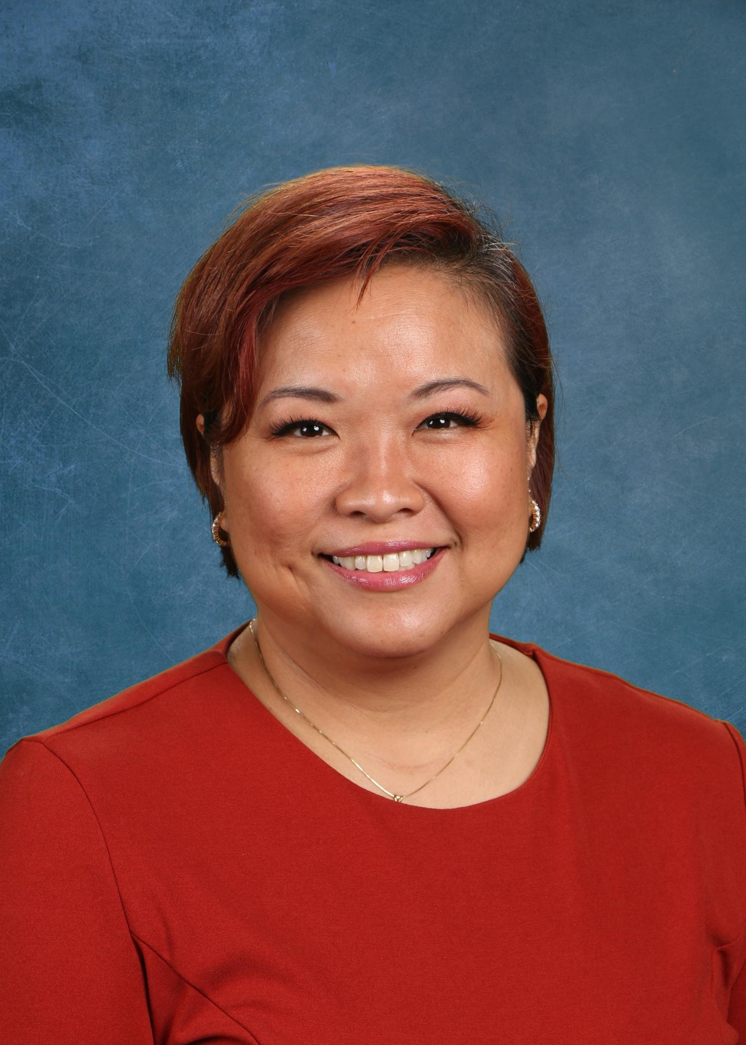
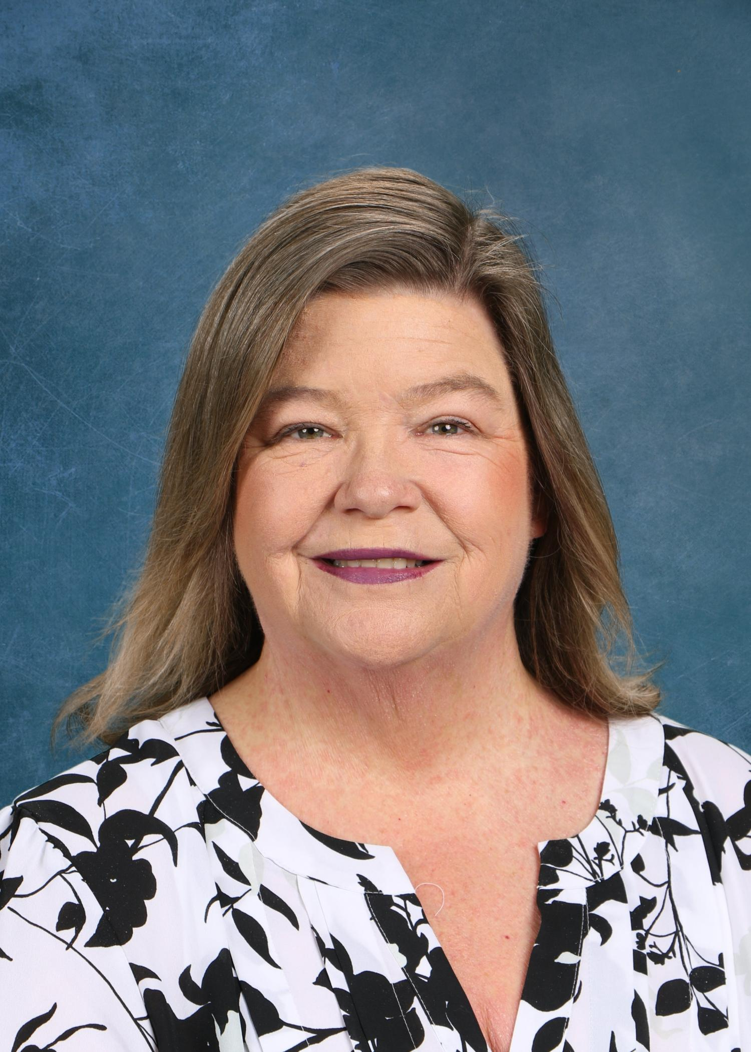
NCMS Administration
Mr. Weeden
Principal
Mrs. Mabra
Assistant Principal
Mrs. Schneider
Assistant Principal

Slide 3
Mr. Gary Weeden
Principal

Slide 4

Our 6th grade team and other staff!
Special thanks to Mrs. Craig, 6th grade science, for helping to organize tonight’s orientation. She is amazing!

Slide 5
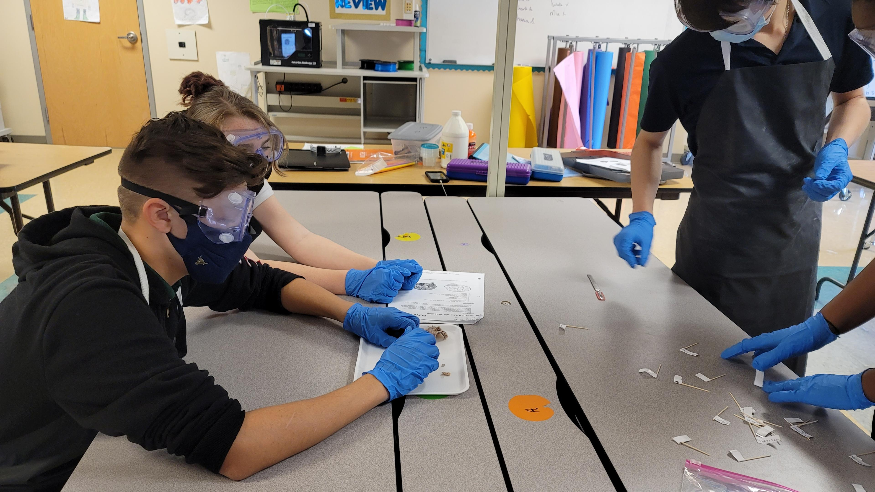
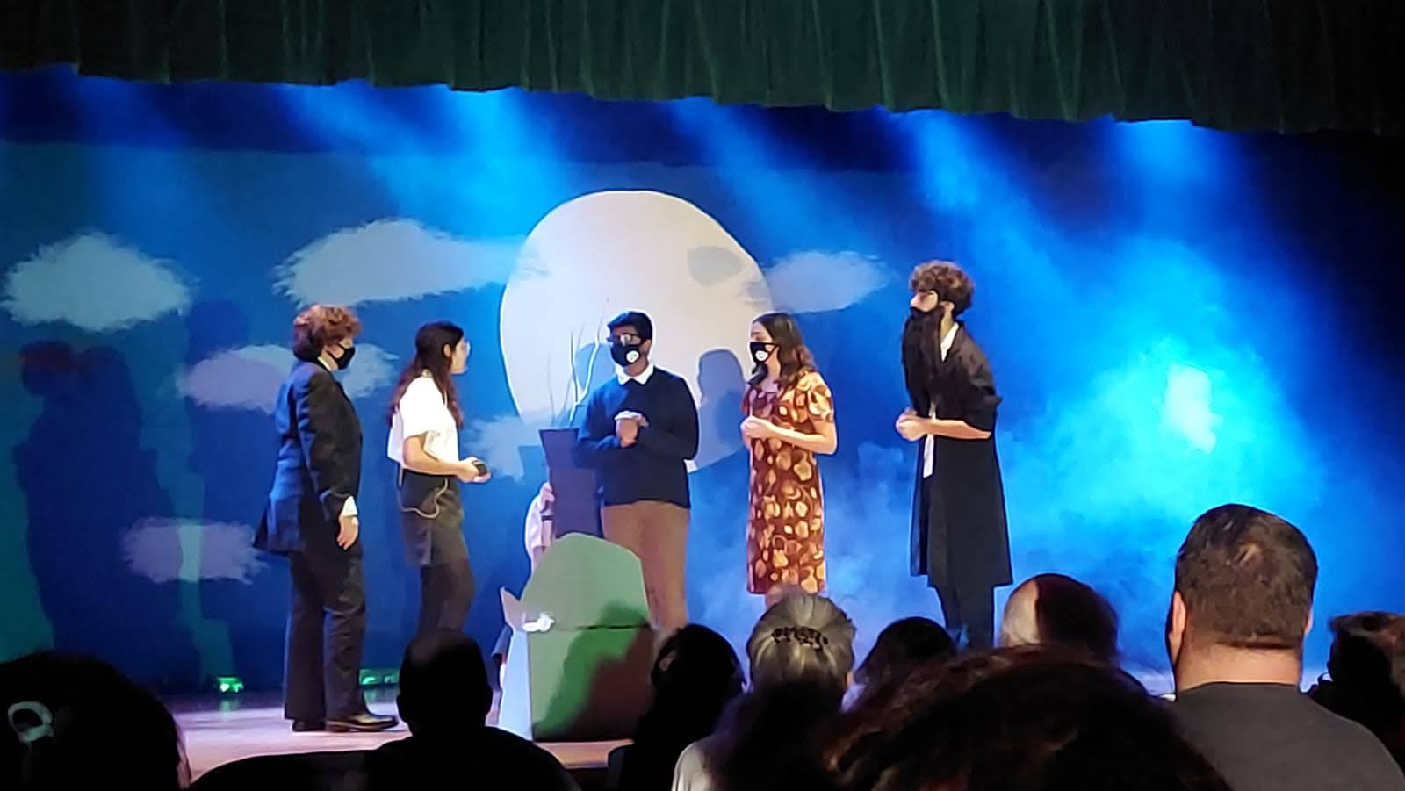
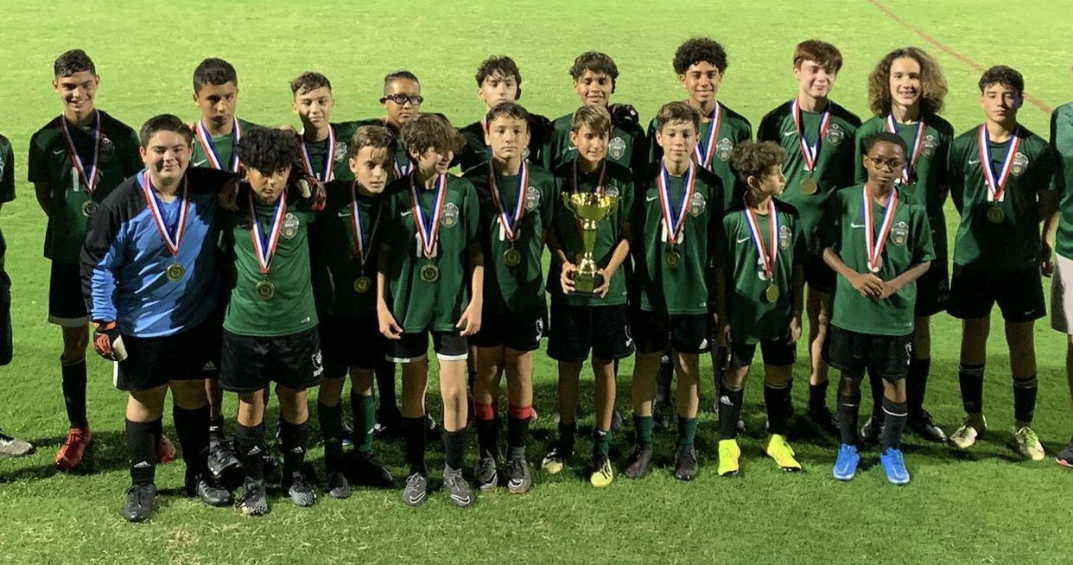
We are Narcoossee!
Great Place to Grow and Learn
Academics + Arts + Athletics = Successful and Well-Rounded Black Bear
AVID National Demonstration School

Slide 6
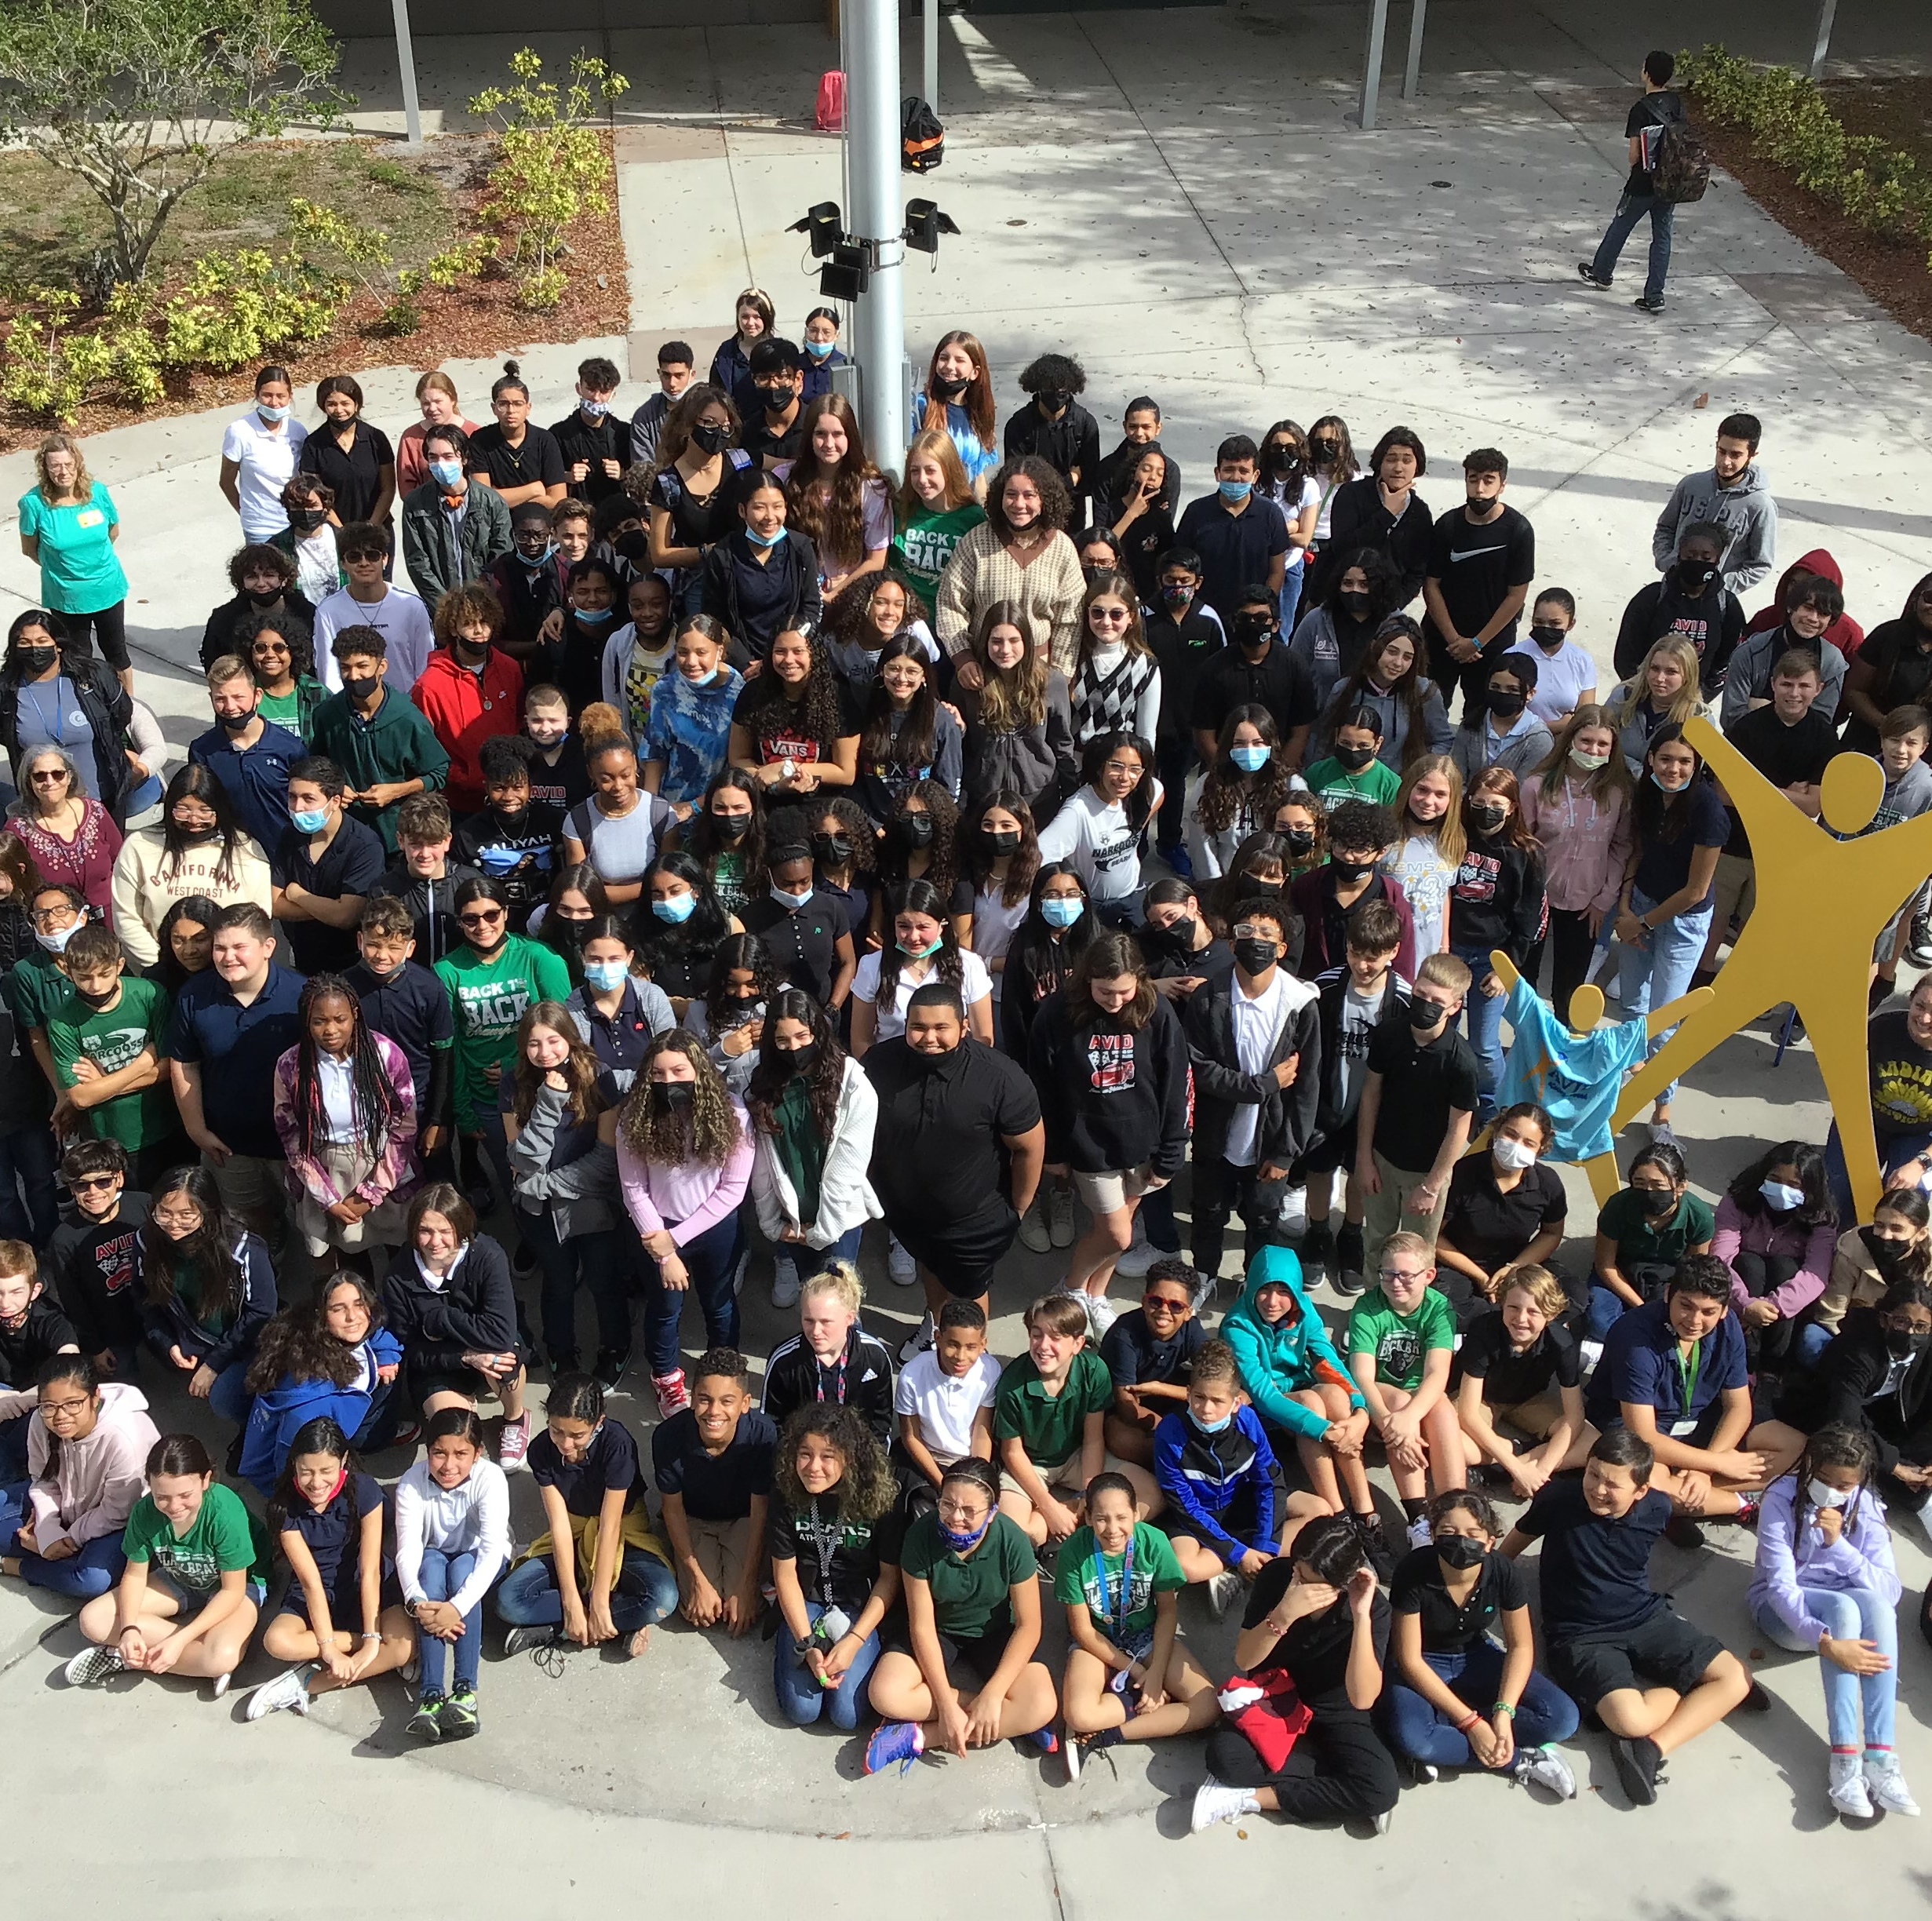

Mrs. Jennifer Kelley—AVID
National Demonstration School
College readiness and student success program
Focus on helping our AVID students succeed in upper lever courses
Strategies are used school wide, but also an elective class
Application/Interview based
Not a remedial program

Slide 7

School and Family Partnership
The most important thing we can do to guarantee student success is to communicate and work together.
Remind
Digital Newsletter
Canvas
TEAMS
Social Media
Email
Guidance

Slide 8

School Advisory Council
SAC is a group made up of parents, teachers, administration and community members.
SAC reviews the school improvement plan and allocate money for school wide programs that fit into the plan.
1st Thursday of each month @ 5:00 PM

Slide 9
Counselors Center
Narcoossee Middle School has four counselors:
  Mrs. Gloria Martinez
  Mrs. Brenda Monroaig-Lopez (6th Grade)
  Ms. Maria Morales (7th Grade)
  Mr. Neil Yeda (8th Grade)
  Counselors can help with academic and/or personal concerns. Students can meet with counselors by scheduling an appointment in the Counseling Center downstairs in Building 5.
  Counselors will also assist families of students with a 504 accommodation plan.

Slide 10
Assistant Principal Mrs. Jane Mabra

Slide 11




NCMS Academics and Educational Opportunities
Language Arts
Math
Reading
Science
Social Studies
Electives
AVID
  Advancement Via Individual Determination
  Ensures all students succeed in a rigorous curriculum, complete a college preparatory path and increase enrollment in four-year colleges
High School Credit Classes
  For 7th and 8th grade students who excel in their regular classes
    Spanish 1 & 2, HOPE, Physical Science Honors, Biology Honors, Algebra Honors, Geometry Honors, World History Honors, Latinos in Action
Academic clubs and competitive teams meet and compete throughout the year

Slide 12
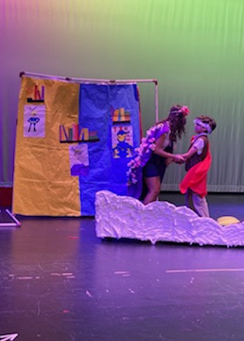
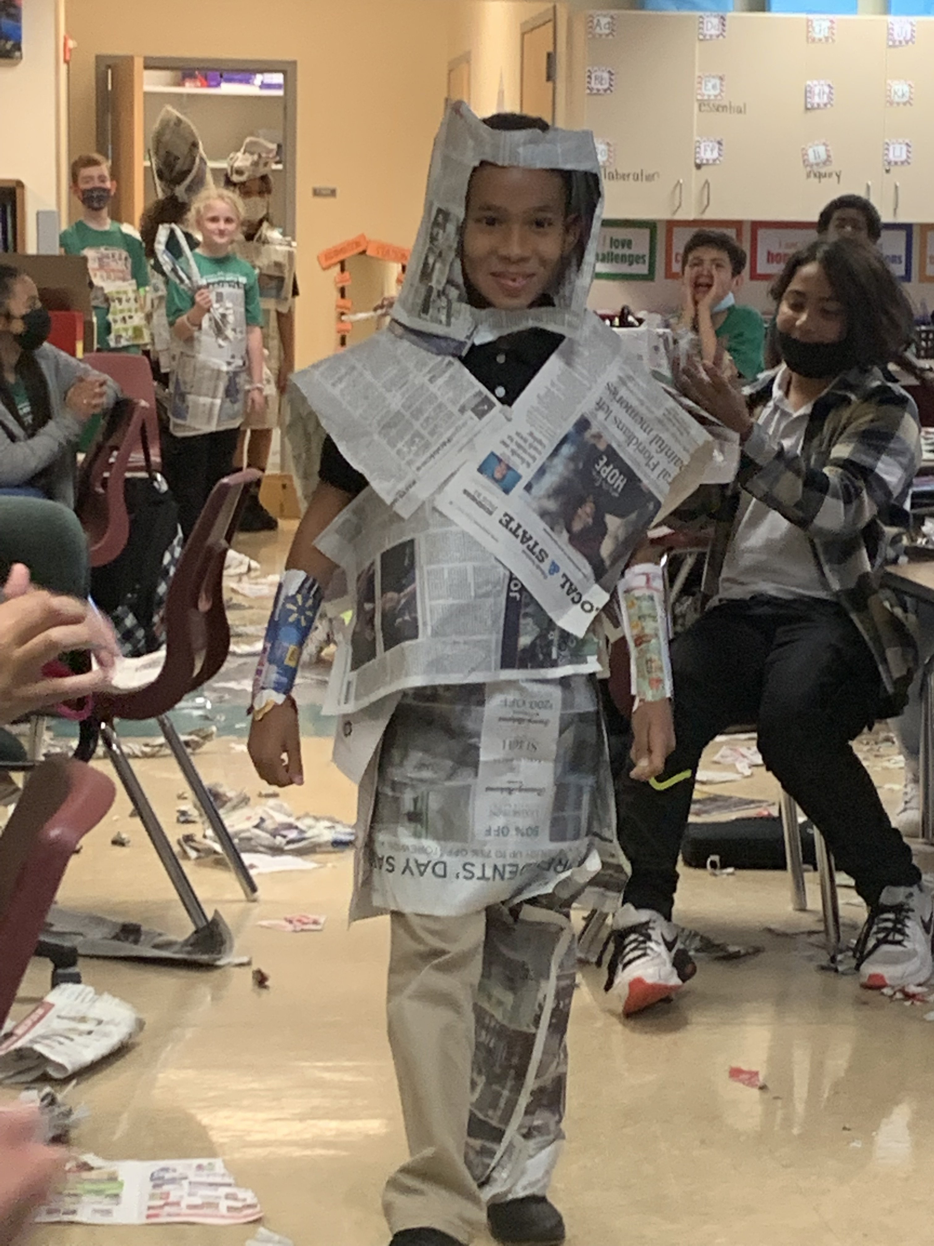
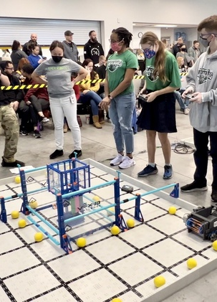
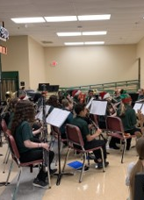
Elective offerings
AVID
Art
Band
Chorus
Computer Applications
Orchestra
PE
STEM (Design and Modeling)
Spanish
Theatre/Musical Theatre

Slide 13
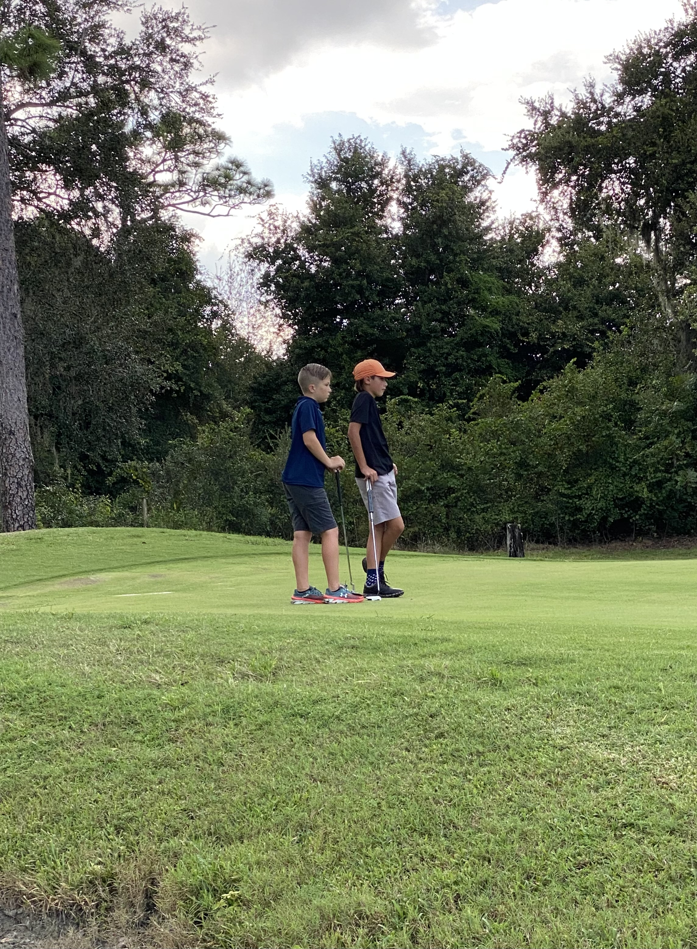
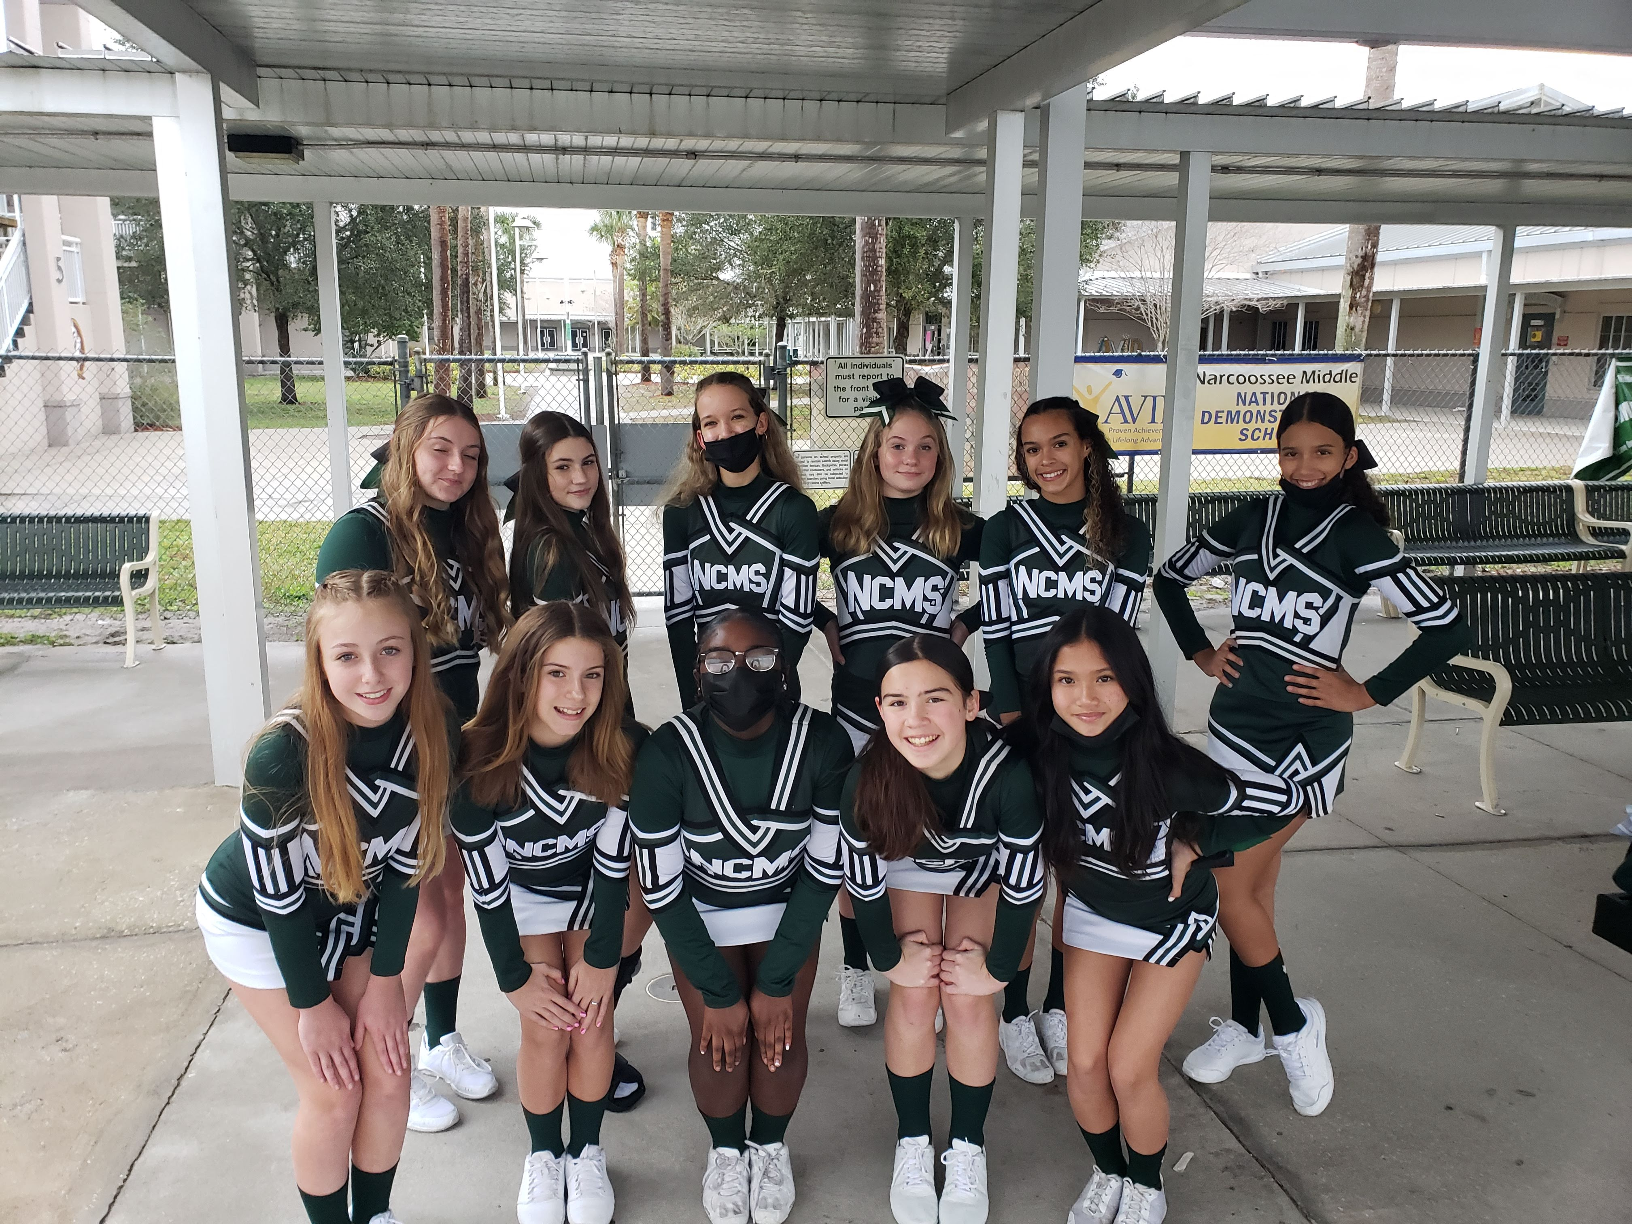
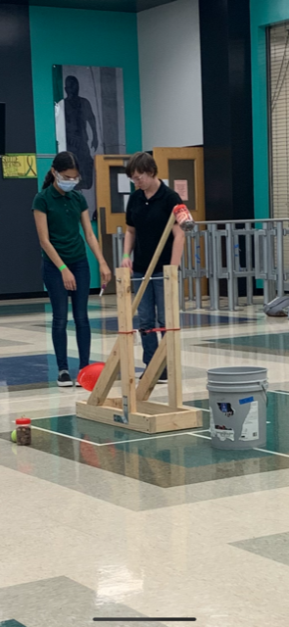
Extra Curricular Activities
Competitive Sports
Clubs
  Basketball
  Cheerleading
  Cross-Country
  Flag Football
  Golf
  Soccer
  Softball
  Track and Field
  Volleyball
  Battle of the Books
  Fellowship of Christian Athletes
  Odyssey of the Mind
  Robotics
  Science Olympiad

Slide 14
Your Personal School Schedule
  Core classes which include Language Arts, Math, Reading, Science, and Social Studies are scheduled first and are based on assessment scores and teacher recommendations.
  Electives are scheduled for students after core classes have been placed into the schedule. Student elective choices are a request and are not guaranteed.
  The scheduling team meets with elementary schools in February each year to complete and collect elective requests. Students will receive one copy of the elective request form to take home.
    Narcoosee Elementary February 3rd
    East Lake Elementary on TBA

Slide 15
Elective Interest Sheet Preview

Slide 16

An Example of a Finalized Schedule
  1st Reading (Research, Intensive Reading or AVID)
  2nd Language Arts (Lang Arts 1, Adv)
  3^{rd Elective 1}
  4^{th Math (Math, Adv)}
  5^{th Lunch}
  6^{th Science (Earth Sci, Adv)}
  7^{th Elective 2}
  8th Social Studies (World History, Adv or US History, Adv)

Slide 17
How can I keep up with what’s happening at NCMS?
Remind
  To get text notifications: TEXT @sdocncms to 81010
School wide emergency call outs—make sure your correct phone number is on file with the school.
NCMS Monthly newsletters
School marquee
Social Media (Instagram/Facebook)
Website – osceolaschools.net/ncms

Slide 18
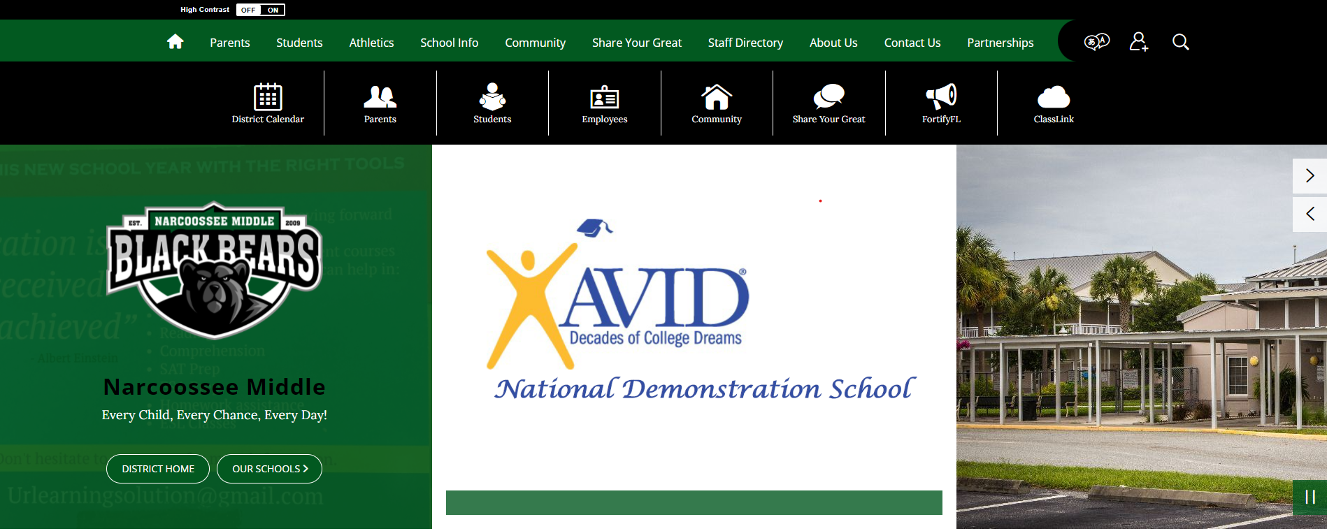
NCMS Website--osceolaschools.net/ncms

Slide 19
How can I communicate with teachers?
School emails are the best way to correspond with teachers
Parents may schedule a meeting or phone/TEAMS conference before school
FOCUS parent portal for monitoring grades, attendance, and behavior

Slide 20

Mrs. Meg Hodge
Resource Compliance Specialist
Assists families of students with IEPs
Schedules annual review and re-evaluation meetings

Slide 21
Assistant Principal Mrs. Lucile Schneider

Slide 22

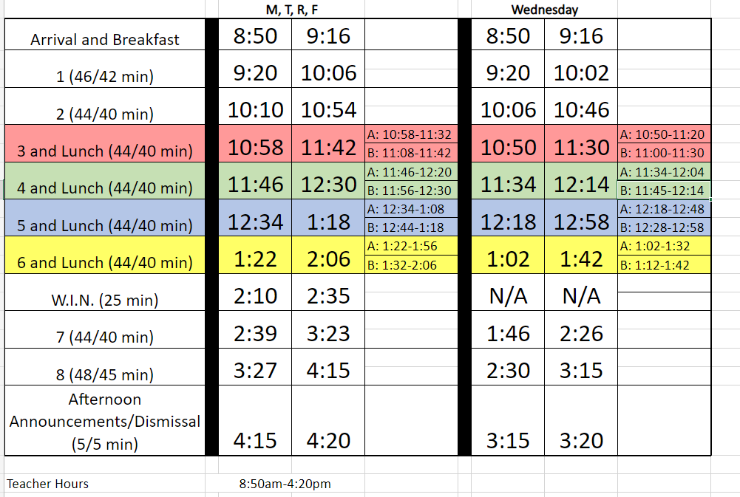

Welcome to 6th Grade!
Sample Bell Schedule – Not for 2023-2024
This Photo by Unknown author is licensed under CC BY-NC-ND.

Slide 23
Student Services
Deans
  Ms. Figueroa – 6th Grade
  Mr. Swanson – 7th Grade
  Ms. Alfred – 8th grade
  Ms. Hopkins – MTSS Coach/Dean
Procedures – Learning as a new 6th grader
PBIS
BEARS expectations
Safety

Slide 24

PBIS – BEARS Expectations
We are proud to be a PBIS School!
  Positive Behavior Interventions and Supports
NCMS Bears know, understand, and live the following expectations
  B – Be Responsible
  E – Encourage Others
  A – Act Safely
  R – Respect All
  S – Strive for Success

Slide 25



PBIS – BEARS Expectations
There are BEARS expectations for all school areas
  Classroom
  Hallways
  Cafeteria
  Buses
  Restrooms
  Computer Usage
Look for the PBIS Posters for reminders

Slide 26
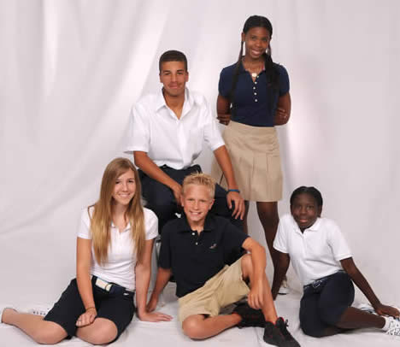
Dress Code
NCMS follows and adheres to the expectations in the School District of Osceola County’s Code of Student Conduct
Polo Colors
  Hunter Green
  Black
  Light Pink
  White
  Navy Blue
Bottoms
  Dark Blue, Black, Khaki
  Denim (Jeans), Twill, Corduroy
Shoes
  Athletic shoes only
  Closed Toe/Heel
Outerwear
  Button-up or zippered

Slide 27

Cell Phones/Electronic Devices
Cell phones are permitted on campus and may be used during the following times
  In the gym during morning arrival
  In the cafeteria during lunch
During the school day, cell phones must be turned off and in student bookbags
  Use of cell phones during class can interfere with learning and academic focus
Other electronic devices should be left at home

Slide 28
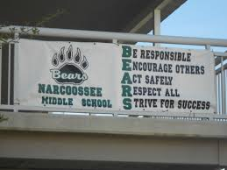
Policies and Procedures are in place to ensure a safe and organized place to learn.
Student code of conduct/ BEARS expectations
Student walking traffic pattern around campus
Morning, lunch and dismissal procedures
Phone usage
Dress Code
Safety Drills

Slide 29

Thanks for visiting. We are looking forward to a great school year.
See you in August for Open House.

Slide 30
osceolaschools.net/ncms

